Slide 1

Advanced course
Lesson 15
Advanced course（6）
Dark automatic alarm
YahBoom Croco:Kit tutorial

Slide 2

Advanced course
Content
Part1
Part 2
Part3
Part 4
Part 5
Learning goals
Preparation
Connection
Search for blocks
Combine blocks
YahBoom Croco:Kit tutorial

Slide 3
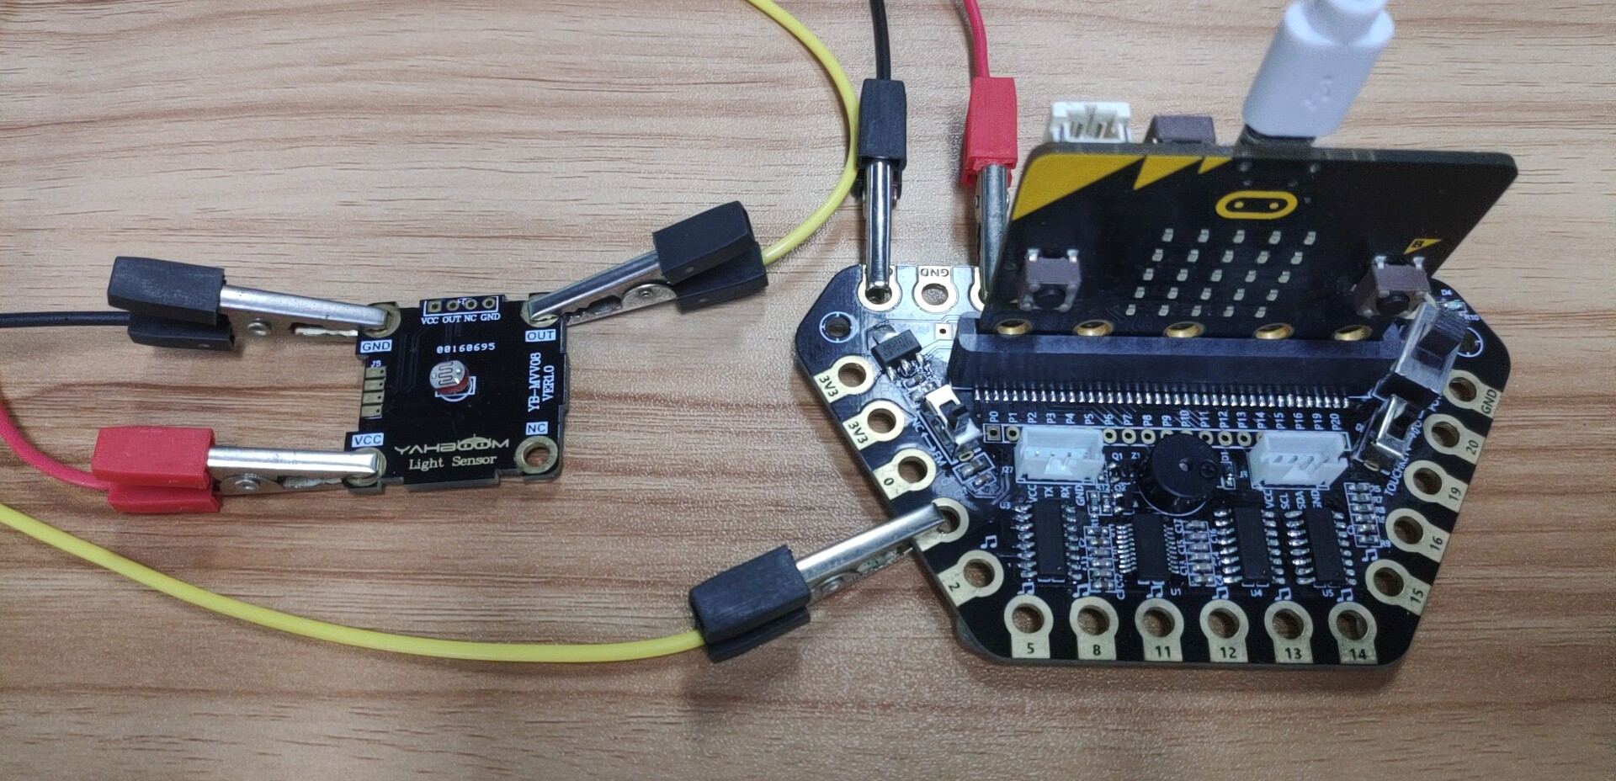
Advanced course
Part 1
Learning goals
After downloading the program, we can see the word 'HELLO!' on the Micro:bit LED dot matrix, then, Micro:bit LED dot matrix will display a smile. If the current ambient brightness is too low, the micro:bit dot matrix will display a crying and the buzzer will play a tone alarm.
YahBoom Croco:Kit tutorial

Slide 4
Advanced course
Part 2
Hardware:
● 1 X Micro: bit Board
● 1 X Micro USB Cable
● 1 X Diamond breakout
● 1 X Photosensitive module
● 3 X Alligator clip
● 1 X PC
Preparation
Mode 1 online programming: First, we need to connect the micro:bit to the computer by USB cable. The computer will pop up a USB flash drive and click on the URL in the USB flash drive: http://microbit.org/ to enter the programming interface. Add the Yahboom package: https://github.com/lzty634158/Croco-Kit to program.
Mode 2 offline programming: We need to open the offline programming software. After the installation is complete, enter the programming interface, click【New Project】, add Yahboom package: https://github.com/lzty634158/Croco-Kit , you can program.
YahBoom Croco:Kit tutorial

Slide 5
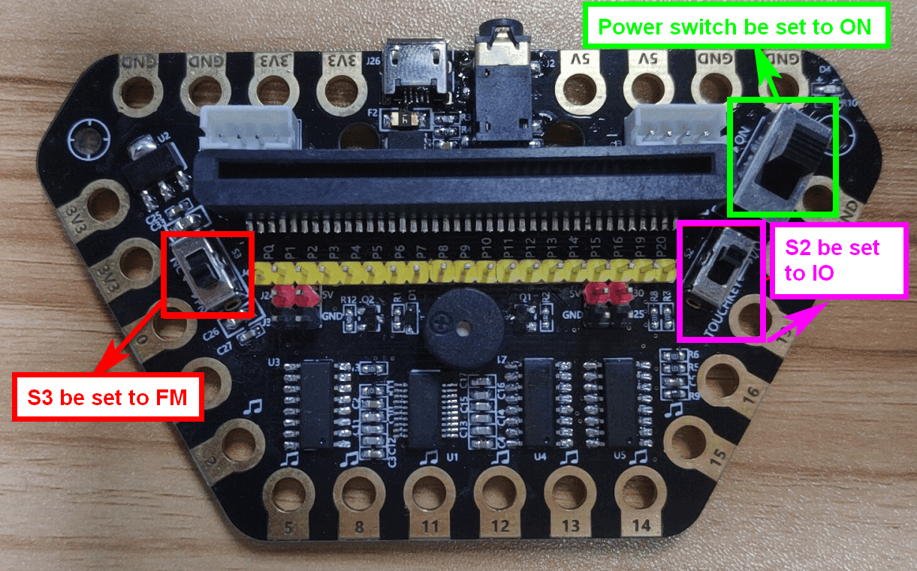
Advanced course
Part 2
Preparation
! ! !Note: S1 be set to the ON, S2 be set to the IO, and S3 to the FM.
YahBoom Croco:Kit tutorial

Slide 6
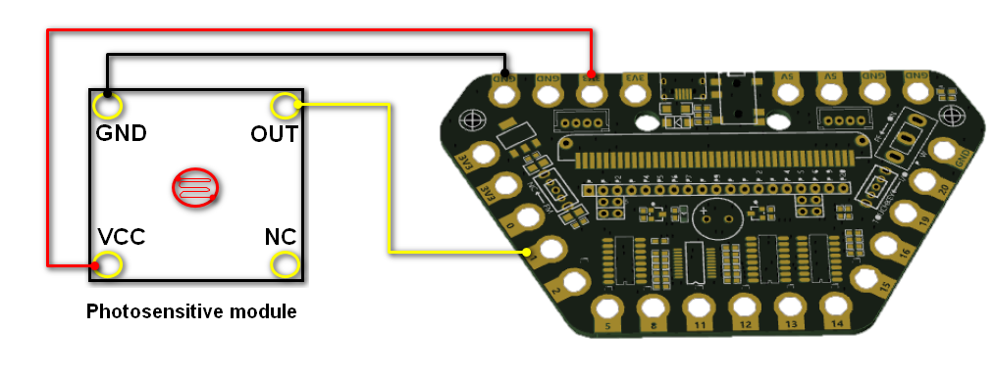
Advanced course
Part 3
Expansion board | Photosensitive module
P1 | OUT
3.3V | VCC
GND | GND
Connection
YahBoom Croco:Kit tutorial

Slide 7
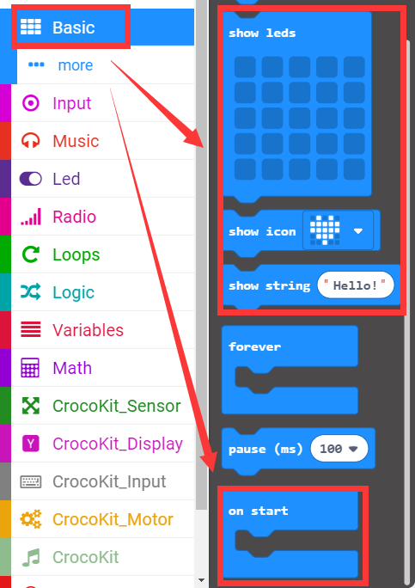
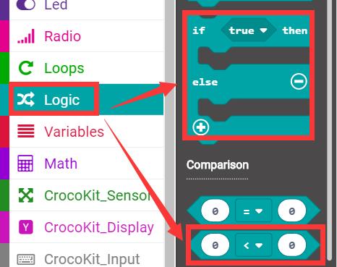
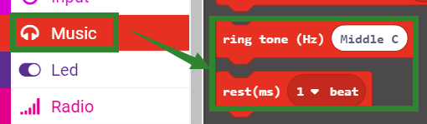
Advanced course
Part 4
Search for blocks
YahBoom Croco:Kit tutorial

Slide 8
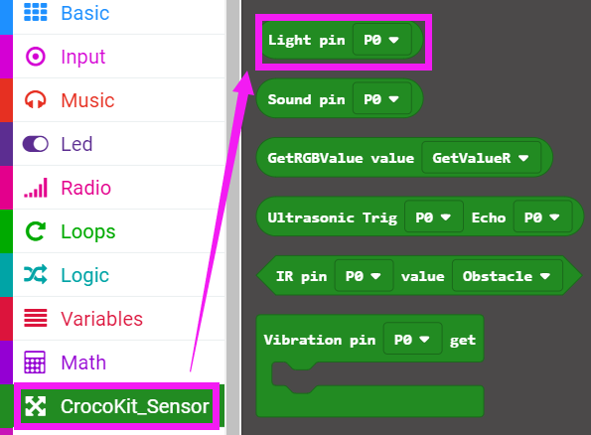
Advanced course
Part 4
Search for blocks
YahBoom Croco:Kit tutorial

Slide 9
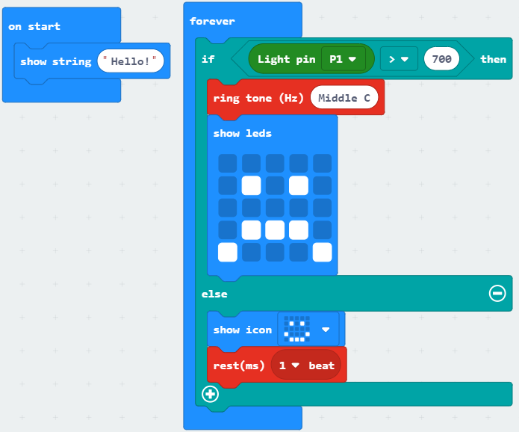
Advanced course
Part 5
Combine blocks
YahBoom Croco:Kit tutorial

Slide 10
Advanced course
Thank you ！
Powered by YahBoom
YahBoom Croco:Kit tutorial

